Slide 1
Cell wall: The outermost layer of cells in plants, bacteria, fungi, and many algae that gives shape to the cell and protects it from infection. In plants, the cell wall is made up mostly of cellulose as well as non-cellulosic polysaccharides (sugars), proteins, lignin and water.
Cell Biology Lec ( 7 )
Cell wall and the chloroplast

Slide 2
Cell wall consists of:
Middle lamella: is first layer formed during cell division. This layer rich in pectin and joins together adjacent plant cells and holds them together.
2.Primary cell wall: It is formed after the middle lamella.in general it is a thin, flexible and extensible layer composed of cellulose, pectin and hemicelluloses.
3.Secondary cell wall: formed inside the primary cell wall. It is a thick layer rich in lignin that strengthens and waterproofs the wall and is formed inside the primary cell wall that has stopped increasing in surface area when the cell is fully grown.

Slide 3
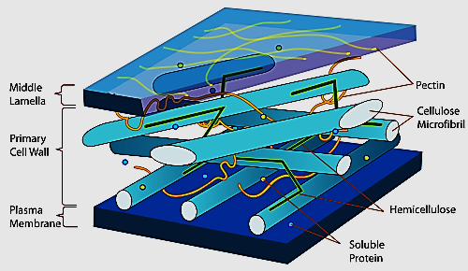
Figure (1): the plant cell wall structure

Slide 4
Cell Wall Function:
1- Gives the cell a definite shape and structure.
2- Provides structural support.
3- Protection against infection and mechanical stress.
4- Separates interior of the cell from the outer environment.
5- It enables transport of substances and information from the cell insides to the exterior and vice versa.
6- Helps in osmotic-regulation.
7- Prevents water loss.
8- The physiological and biochemical activity of the cell wall helps in cell-cell communication.

Slide 5
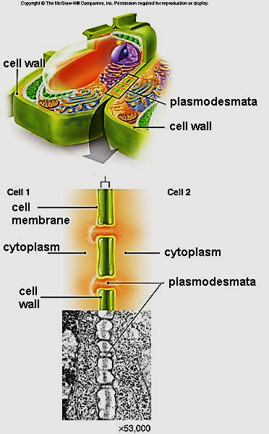
Plasmodesmata: are small holes in the wall that let nutrients, waste, and ions pass through.

Slide 6
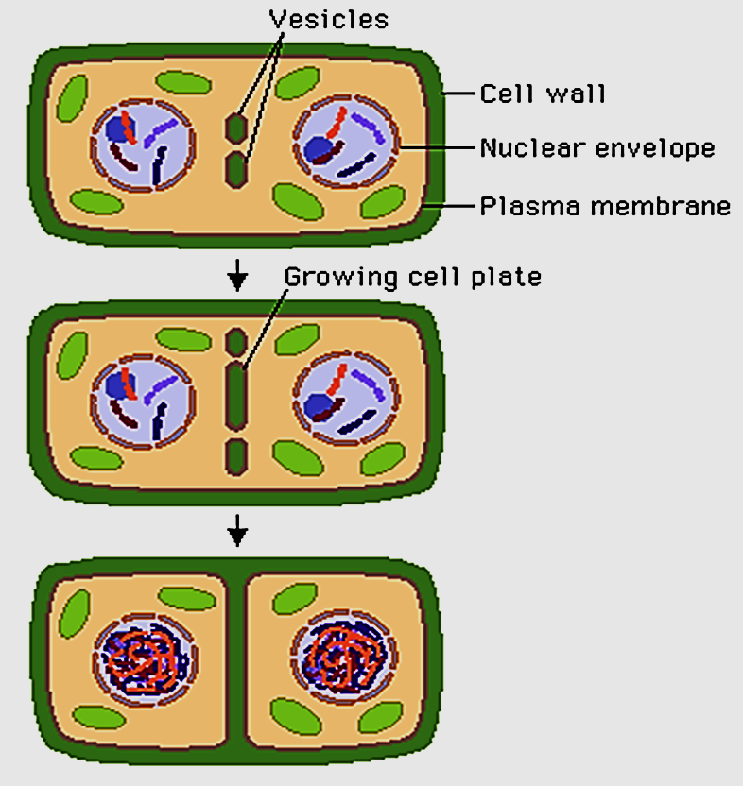
Cell wall division: Plant cells have walls, so cytokinesis cannot proceed with a cleavage furrow. Instead, during telophase a cell plate forms across the cell in the location of the old metaphase plate.

Slide 7
The chloroplast and other plastids
In 1883 Schimper first used the term "Plastid" for special cytoplasmic organelles present in eukaryotic plant cells.
Chloroplast is characterized by the presence of pigments such as chlorophyll and carotenoids and by their fundamental role in photosynthesis.
There are other colored plastids these are grouped under the name chromoplasts.
Yellow or orange chromoplasts occur in petals, fruits, and roots of certain higher plants.
Red color of ripe tomatoes is the result of chromoplasts that contain the red pigment lycopene.
Colorless plastids or leucoplasts are found in embryonic and germ cells.

Slide 8
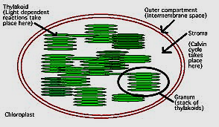
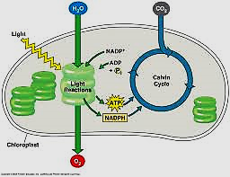
Figure (3): chloroplast and photosynthesis in higher plants

